Slide 1

Financial Analytics and Machine Learning
Prof. Simona Paravani-Mellinghoff, Prof. Fabrizio Coiai | UCL Institute of Finance and Technology
s.paravani@ucl.ac.uk

Slide 2
NLP Techniques and Use in Finance

Slide 3
Focus of the day
Discussion of Fed’s paper
NLP & Machine Learning
NLP and Finance: A few use cases
Let’s practice

Slide 4
Key learnings:
Very clear purpose and thesis: Assess predictive accuracy of sentiment analysis NLP based models, hence their potential as substitutes to traditional survey based measures.
Size of universe: 231k articles from 16 papers spanning period 01/1980 to 04/2015. Apply key filters:
1. LN classiﬁed “country subject” as “United States” (with an LN “relevance” threshold of at least 85%).
2. LN classiﬁed “topic subject” as “Economy” or “Economic” (with an LN “relevance” threshold of at least 85%).
3. LN did NOT classify the article as a “Brief” or “Summary” or “Digest.“
4. Article had 200 words or longer.
5. Article contained at least one of the following words: said, says, told, stated, wrote, reported.

Slide 5
Key learnings
Assess coverage of your lexicon-Table 1
Define a benchmark of what good looks like-800 articles rated by Fed researchers- “human benchmark”
Assess how the various lexicon options perform relative to the human benchmark. Key techniques: Spearman rank correlation, R2 from an OLS regression of the human ratings on the model scores, the pseudo-R2 from an ordered logit regression, Macro-F1 statistic of classiﬁcation accuracy

Slide 6
Key learnings
How to enhance the lexicon to deal with “unclassified” words
Assign a sentiment class to each sentence using modified Vader
Create a word-by-class matrix, counting the co-occurrence of each word with each of the sentiment classes.
Estimate the implied sentiment association of each word via PMI (“pointwise mutual information”)
Build an index based on the new news sentiment metric and measure correlation with established surveys of economic activity

Slide 7
NLP & Machine Learning

Slide 8
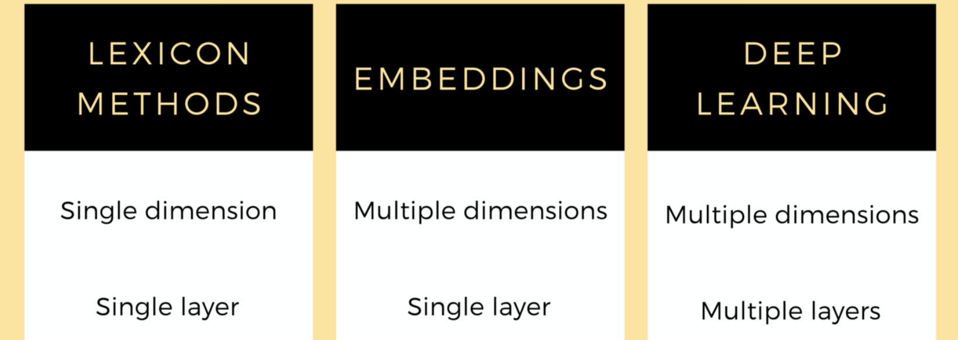
Source: How NLP has evolved for Financial Sentiment Analysis | by Neo Yi Peng | Towards Data Science

Slide 9
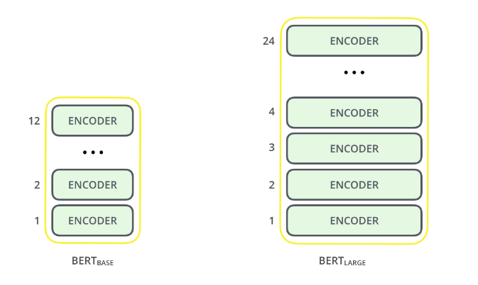
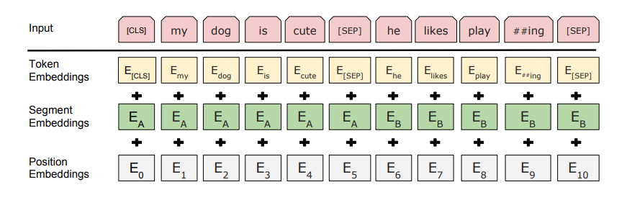
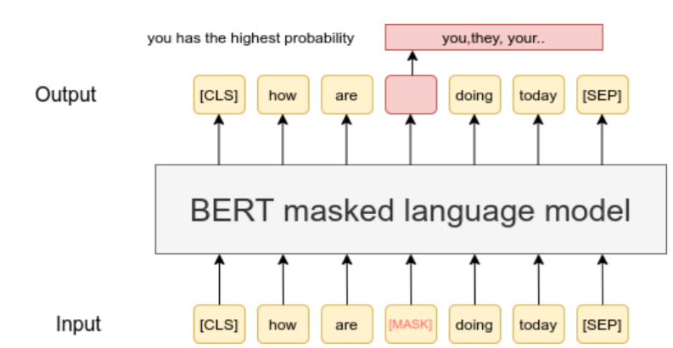
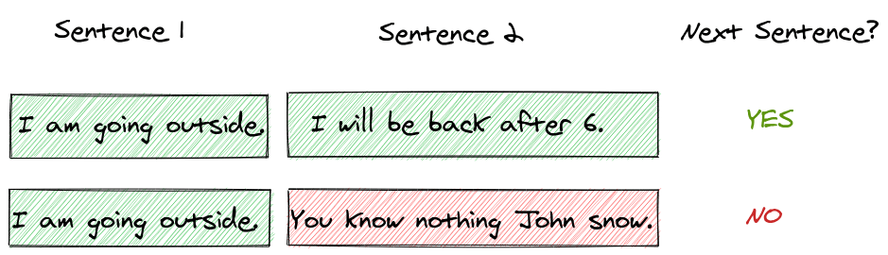
NLP - BERT
1) Architecture
The BERT architecture builds on top of Transformer. We currently have two variants available:
-BERT Base: 12 layers (transformer blocks), 12 attention heads, and 110 million parameters
-BERT Large: 24 layers (transformer blocks), 16 attention heads and, 340 million parameters
2) Preprocessing
Position, segment and token embeddings: For a given token, its input representation is constructed by summing the corresponding token, segment, and position embeddings.
3b) Next sentence prediction ↓
3a) Masked Language Modelling ➔

Slide 10
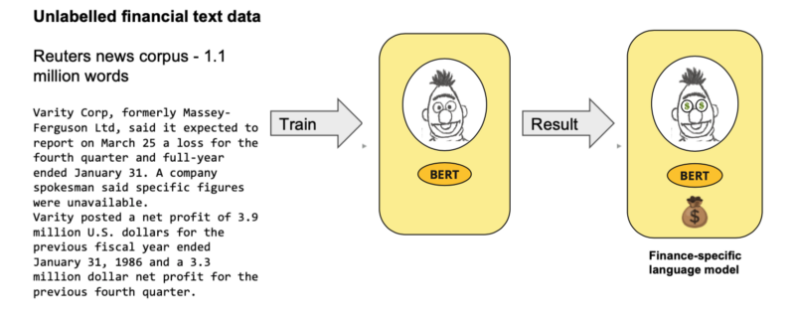
FinBERT
A pre-trained NLP model to analyse sentiment of financial text. It is built by further training the BERT language model in the finance domain, using a large financial corpus and thereby fine-tuning it for financial sentiment classification.
Source: Aracı, D. (2019). FinBERT: Financial Sentiment Analysis with Pre-trained Language Models. ArXiv.
Available at: https://arxiv.org/pdf/1908.10063.pdf

Slide 11
NLP and Finance: USE cases

Slide 12
Recommended readings:
https://www.fintext.io/how-finance-uses-nlp/
Next-level NLP and potential ESG controversies | Refinitiv Perspectives
Evaluation of Sentiment Analysis in Finance: From Lexicons to Transformers - IEEE Journals & Magazine
Comprehensive review of text-mining applications in finance | SpringerLink

Slide 13
Let’s practice

Slide 14
Classroom exercise
sample: from 2016-01-01 to 2021-01-01
download daily news (WSJ and USA today) on Amazon
aggregate news weekly
compute sentiment indicator using the LM dictionary and tf-idf
download and compute Amazon and the SP500 weekly log returns
compute Amazon excess returns
compute correlation measures between Amazon next week excess returns and the sentiment indicator
compute accuracy of the sentiment indicator in signalling positive excess returns (next week). Where would you set the signalling threshold on the sentiment indicator? Why?
repeat exercise using FinBERT for constructing sentiment indicator and compare and contrast results vs lexicon based approach

Slide 15
All materials, including video lectures, can be used only and exclusively in relation to the Financial Analytics and Machine Learning course for the MSc in Banking and Digital Finance 2020/2021.No download, dissemination or reproduction is allowed.

Slide 16
Appendix

Slide 17
Word2Vec
Word2Vec is a shallow, two-layer neural networks which is trained to reconstruct linguistic contexts of words. It takes as its input a large corpus of words and produces a vector space, typically of several hundred dimensions, with each unique word in the corpus being assigned a corresponding vector in the space.
The effectiveness of Word2Vec comes from its ability to group together vectors of similar words. Given a large enough dataset, Word2Vec can make strong estimates about a words meaning based on their occurrences in the text. These estimates yield word associations with other words in the corpus.
https://towardsdatascience.com/word2vec-explained-49c52b4ccb71
https://medium.com/analytics-vidhya/neural-networks-for-word-embeddings-4b49e0e9c955

Slide 18
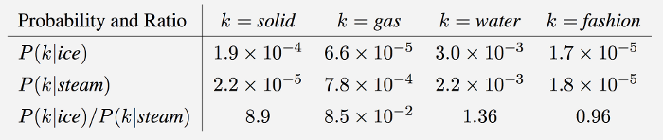
Glove
GloVe is an unsupervised learning algorithm for obtaining vector representations for words. Training is performed on aggregated global word-word co-occurrence statistics from a corpus, and the resulting representations showcase interesting linear substructures of the word vector space.
It is essentially a log-bilinear model with a weighted least-squares objective. The main intuition underlying the model is the simple observation that ratios of word-word co-occurrence probabilities have the potential for encoding some form of meaning. For example, consider the co-occurrence probabilities for target words ice and steam with various probe words from the vocabulary. Here are some actual probabilities from a 6 billion word corpus:
https://nlp.stanford.edu/projects/glove/

Slide 19
ELMO
Traditional word-embedding (word2vec, GloVe) fails to recognise context
ELMO is not just a representation of words in a dictionary and their corresponding vector, but attempts to represent/analyse a word in the context

Slide 20
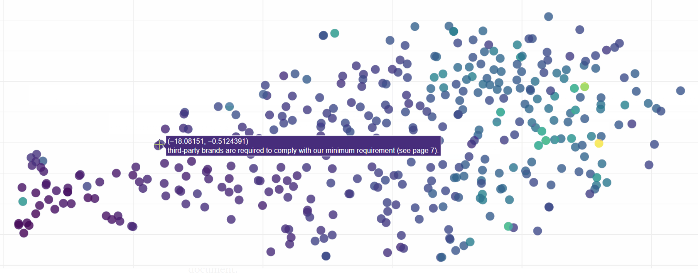
ELMO
Source: ELMo: Contextual language embedding | by Josh Taylor | Towards Data Science

